Slide 1


CAPSTONE PROJECT
Student Marks & Result Analysis
Presented By
Student Name: RISHIT GHOSH
College Name: GEETHANJALI COLLEGE OF ENGINEERING AND TECHNOLOGY
Department: CSE – AI&ML
Email ID: rishitghosh06@gmail.com

Slide 2
OUTLINE:
Problem Statement (Should not include solution)
Proposed System/Solution
System Development Approach (Technology Used)
Algorithm & Deployment
Result (Output Image)
Conclusion
Future Scope
References

Slide 3
Problem Statement:
Educational institutions often struggle to analyze student performance across subjects, grades, and pass/fail outcomes in a consolidated and insightful manner. Manual tracking of academic metrics lacks interactivity and scalability, making it difficult to identify trends, top performers, or areas needing improvement.

Slide 4
Proposed Solution:
This system is designed to transform raw academic data into clear, interactive insights. By using Power BI, educators and administrators can quickly identify trends, strengths, and areas needing improvement in student performance.
Data Collection
Core inputs include student marks, grades, subjects, and exam results.
Optional extensions: attendance data, teacher assignments, or term-wise performance.
Data Preprocessing
Raw data is cleaned to remove duplicates, handle missing values, and standardize formats.
Structured into an Excel dataset with clear relationships (students to subjects to results).
Derived fields such as pass percentage, average marks, and top scorer identification are calculated for deeper analysis.
Visualization
Interactive Dashboard with:
Slicers for filtering by class, subject, exam type, or academic year.
Charts (bar, line, pie) to show subject-wise averages, grade distributions, and performance trends.
Deployment
Reports can be exported to PDF or Excel for sharing with teachers, parents, or school boards.
Future scalability: integration with Power BI Service for cloud access, role-based sharing, and mobile viewing.
Benefits
Teachers: Identify weak subjects and struggling students quickly.
Parents/Students: Transparent reporting of progress.
Institution: Data-driven decisions to improve teaching strategies and curriculum design.

Slide 5
System Approach:
System Requirements: Power BI Desktop, Excel
Libraries/Tools Used:
Power BI visuals: Card, Pie chart, Bar chart, Table, Slicer.
DAX measures for average, top scorer, and conditional formatting.
Excel for data preparation.

Slide 6
Algorithm & Deployment:
Logic:
Top Scorer Identification: DAX formula to extract max marks and corresponding student name
Pass Percentage: Calculated using DAX based on Result column
Subject-wise Average: Aggregated using bar chart visual
Conditional Formatting: Applied to Result and Grade columns for visual clarity
Deployment:
Dashboard created in Power BI Desktop
Exported as screenshot and .pbix file for submission
Interactive slicers allow filtering by Subject, Grade, and Result

Slide 7
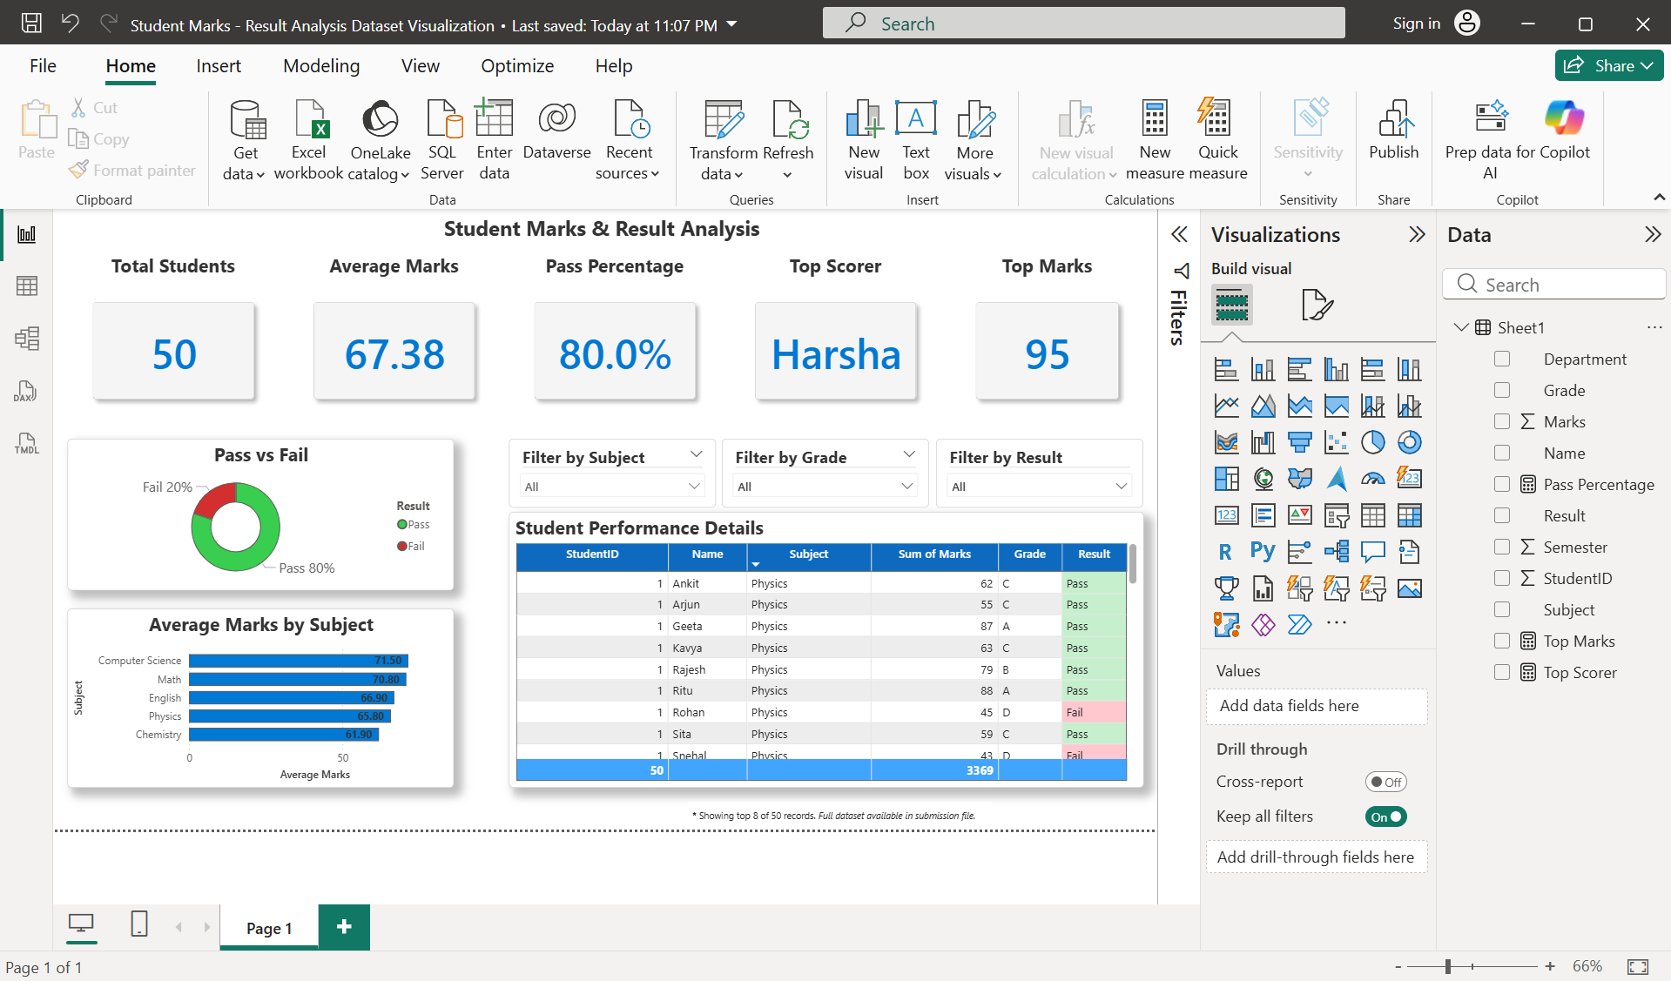
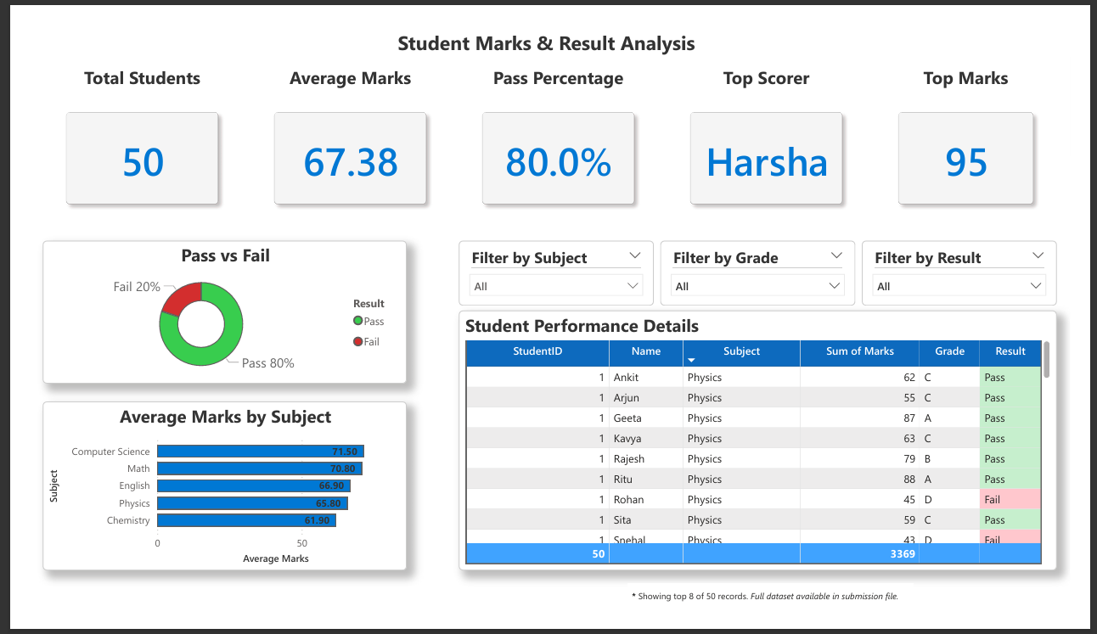
Result:
Key Highlights:
Total Students: 50
Average Marks: 67.38
Pass Percentage: 80%
Top Scorer: Harsha (95 marks)
Subject-wise insights and dynamic filtering

Slide 8
Conclusion:
The dashboard provides a clear and interactive view of student performance, making complex academic data easy to understand. It allows educators to simplify analysis by presenting marks, grades, and results in a structured and visually appealing format. Key features include the ability to highlight top performers, track overall pass percentages, and monitor average marks across different subjects. With subject-wise insights, teachers can quickly identify areas where students excel and where additional support may be needed. The interactive filters and charts enable dynamic exploration, ensuring that performance trends can be analyzed at both individual and class levels.
By leveraging Power BI, the system offers scalability, professional presentation, and export options, making it suitable for both local use and potential institutional deployment. Ultimately, it serves as a powerful tool for data-driven decision-making in education.

Slide 9
Future scope:
Add Semester-wise and Department-level Filters:
Enhance the dashboard with advanced filtering options that allow users to view performance data by semester, department, or specialization. This will provide more granular insights and help identify trends across different academic units.
Integrate Real-time Data from Academic Portals:
Connect the dashboard directly to institutional academic portals or ERP systems. Real-time integration ensures that performance metrics are always up to date, reducing manual data entry and improving accuracy.
Expand to Include Attendance and Internal Assessments:
Incorporate additional datasets such as attendance records, class participation, and internal assessment scores. This will give a more holistic view of student performance beyond exam results.
Introduce Predictive Analytics:
Use machine learning models within Power BI to forecast student outcomes, identify at-risk students, and suggest targeted interventions. Predictive insights can help educators take proactive measures to improve academic success.

Slide 10
References:
https://learn.microsoft.com/en-us/power-bi/
https://learn.microsoft.com/en-us/training/modules/introduction-power-bi/
https://www.geeksforgeeks.org/power-bi/power-bi-tutorial/
GitHub Link: Link

Slide 11
Thank You

